Slide 1

Entity Detection & Naming – Best Practice
March 2019
Kevin Leng
Dynatrace Guy

Slide 2
Agenda
Custom agent installation
Host Groups
Management Zones
WebSphere Pitfalls
Q&A
Notes:
If you are to automate monitoring, need to make sure Dynatrace is set up correctly.
Having these challenges through support.
All because they didn’t do thorfought

Slide 3
Environment
Ensure You are connected to
Both EC2 instances
Your Dynatrace tenant (I recommend you do this within your environment)
Slack (Using web browser or desktop app)

Slide 4
Staging
Production

Slide 5
What challenges will I face?

Slide 6



Custom agent installation
Agenda
item 1
item 2
item 3

Slide 7
Customize OneAgent installation on Windows
SERVER
TENANT
TENANT_TOKEN
HOST_GROUP
PROXY
APP_LOG_CONTENT_ACCESS
INSTALL_PATH
INFRA_ONLY
INSTALLATION.LOG
USER
Use the Windows Group Policy installer with command line parameters

Slide 8
Customize OneAgent installation on LINUX
SERVER
TENANT
TENANT_TOKEN
HOST_GROUP
PROXY
APP_LOG_CONTENT_ACCESS
DISABLE_SYSTEM_LOGS_ACCESS
INSTALL_PATH
INFRA_ONLY
-p (preserves SELinux policy sources)
-n (skips SELinux policy installation)*
INSTALLATION.LOG
USER
GROUP
NON_ROOT_USER
DISABLE_ROOT_FALLBACK
Use the Linux installer with command line parameters
* Note you'll need to create a custom policy rule for OneAgent yourself. You don't have to use this parameter if SELinux is disabled on your server.

Slide 9
Agenda
item 1
item 2
item 3

Slide 10
Host Groups
Agenda
item 1
item 2
item 3

Slide 11
Why would I need a Host Group?
Environments are getting larger and larger, often spanning different data centers and multiple applications
This increases the need for segmenting a large environment into different groups and configuring each group differently
Use Cases
Monitoring multiple environments of the same application in the same environment (DEV, INT, PRD)
Need to split process groups automatically, without defining environment variables per host/process

Slide 12
How to Configure
A host can only be assigned to a host group at the time of installing the OneAgent
The Linux installer has a new installation option for that
HOST_GROUP=MyHostGroup
The Windows installer asks for the host group
After the installation is complete the host group is statically assigned to the host
Each host belongs to at most one host group and the host group can only be changed by re-installing the agent

Slide 13
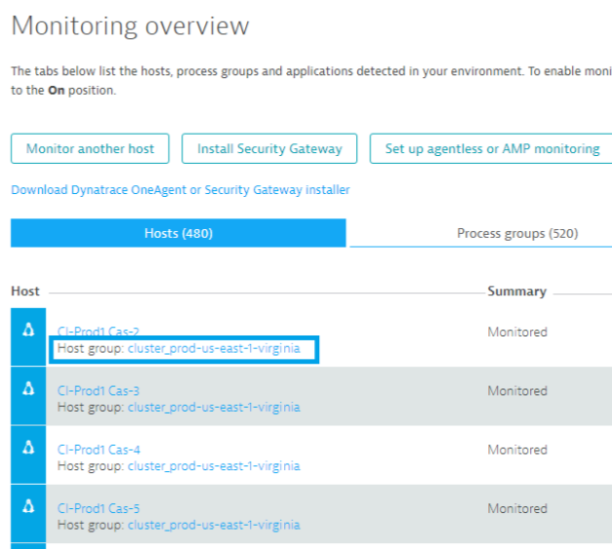
Host Groups

Slide 14
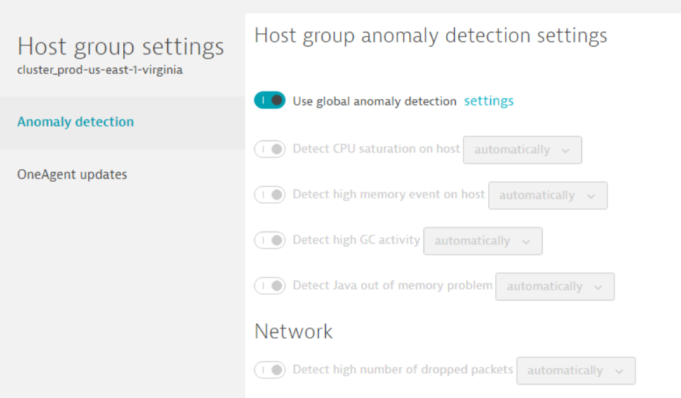
How does it affect the monitoring?
Hosts can now be configured on the host group level
This makes changing settings for a large number of hosts much easier
You can define alerting thresholds and agent update settings on a per host group

Slide 15
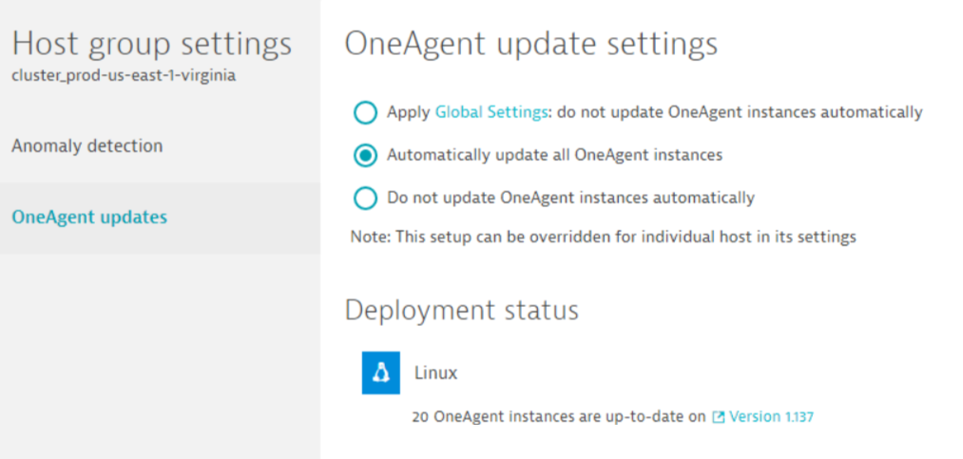
How does it affect the monitoring?
You can also define the OneAgent update settings and even trigger the update of all OneAgent installations of a host group

Slide 16
How does it affect the monitoring?
Additionally, host groups affect how process groups are detected
When the same process is running in two different host groups, Dynatrace will create one process group for each host group
This means you can also configure process groups differently, depending on which host group they are running in
Consequently also services will be separated per host group
You can configure services differently per host group

Slide 17
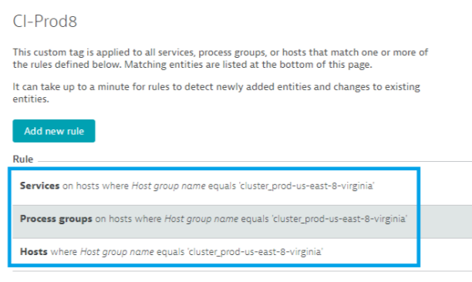
How does it affect the monitoring?
Host groups can also be used in tagging rules and for defining Management Zones so you can apply additional context information to the different entities in Dynatrace based on host groups

Slide 18
Hands On: Host Groups

Slide 19
Hands On: Host Groups
Goal: Install OneAgent on your production & test hosts with appropriate host groups
Steps:
Download MSI package
Modify the Exercise 1 – AgentInstall.bat file with the appropriate information. The appropriate info can be found in the intall.bat file contained in the MSI package
Run the Exercise 1 – AgentInstall.bat file on both hosts
Check the deployment on the Deployment Status page

Slide 20
Hands On: Host Groups
Goal: Install OneAgent on your production & test hosts with appropriate host groups
Steps: https://github.com/KevLeng/ConfigurationAPI-HandsOn
Follow Steps in Lab 1

Slide 21
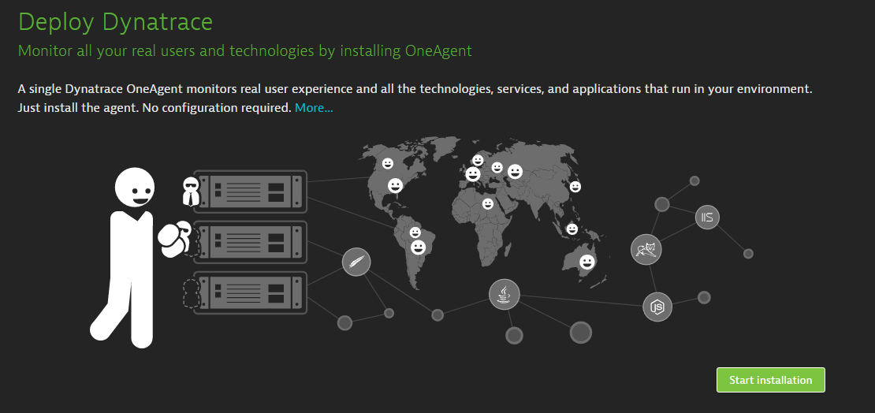
Hands On: OneAgent

Slide 22
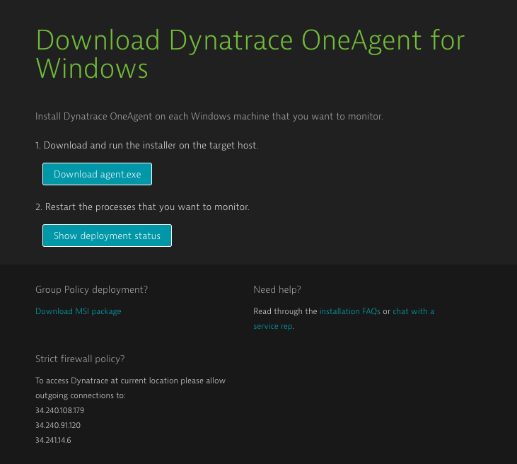
Hands On: OneAgent

Slide 23
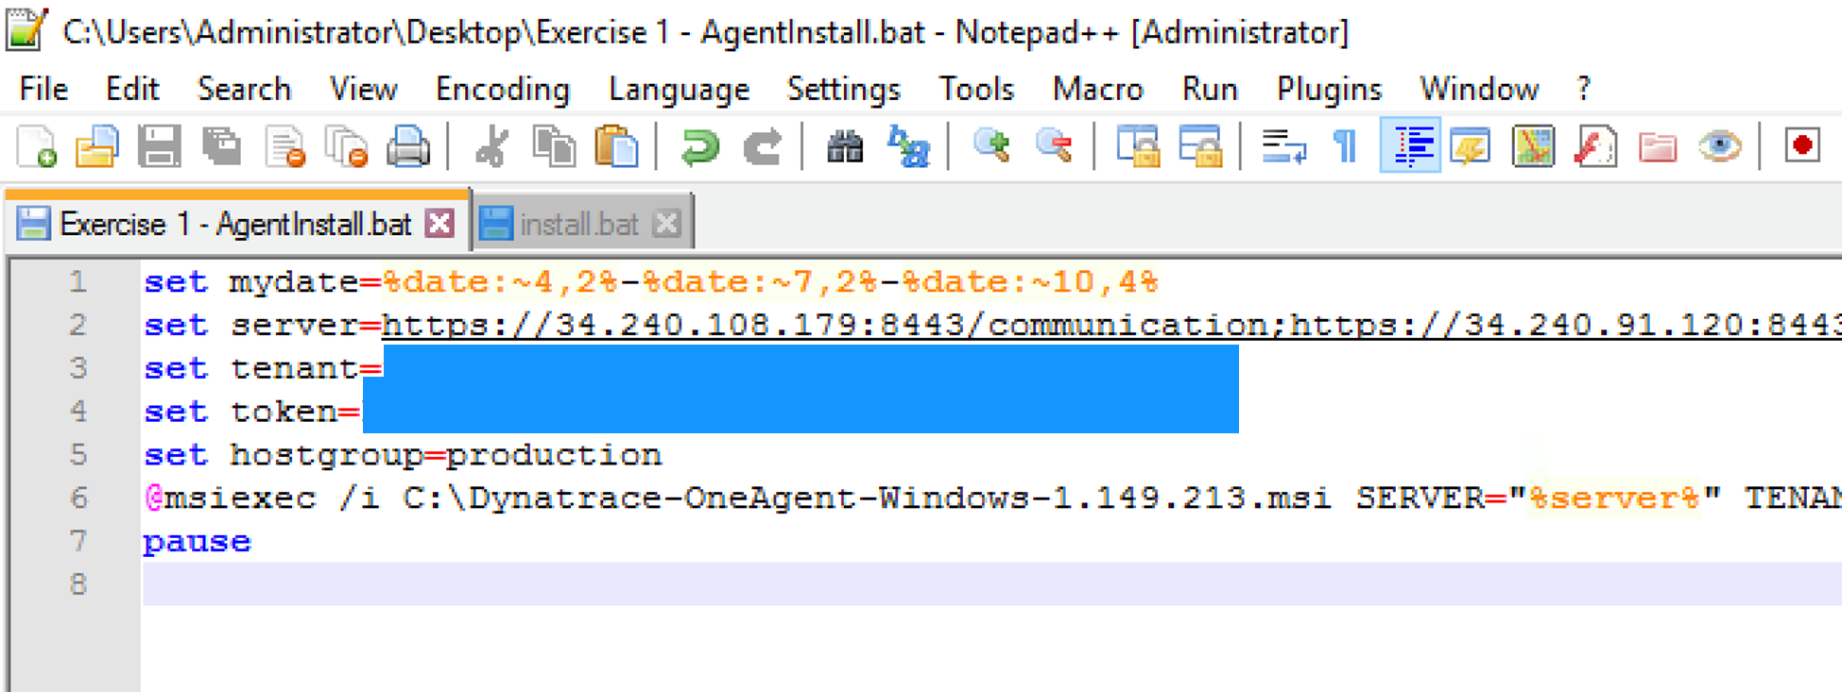
Hands On: OneAgent

Slide 24
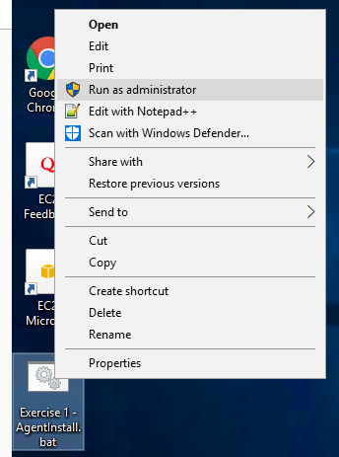
Hands On: OneAgent
Right click on the Exercise1 – AgentInstall.bat file
Select Run as administrator

Slide 25
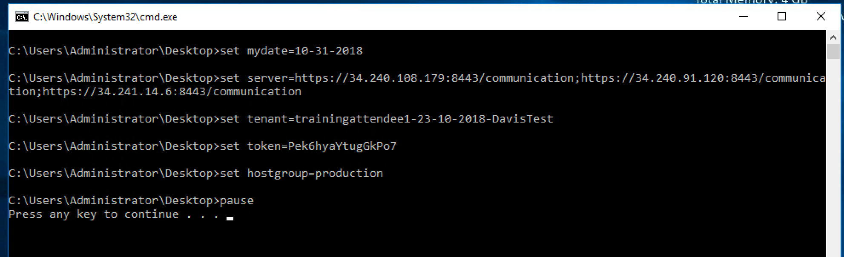
Hands On: OneAgent

Slide 26
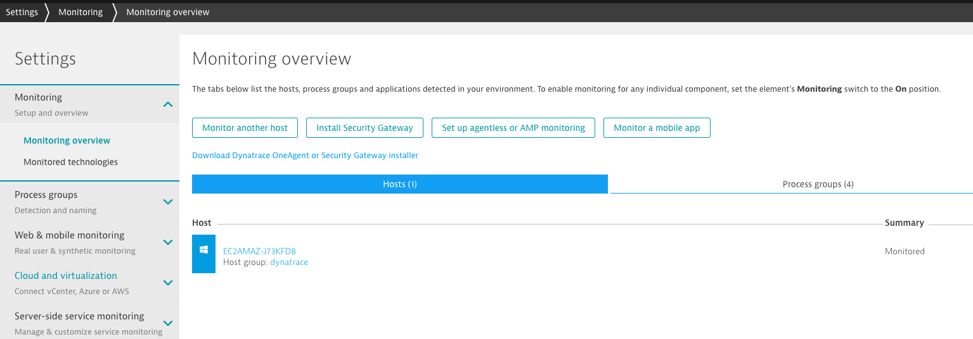
Hands On: OneAgent

Slide 27
Gather the required settings
Cluster Domain - mvv888.dynatrace-managed.com (same for everyone)
Environment ID – trainingattendee……… (use your unique value)
Installer API Token - (use your unique value)
https://{your-domain}/e/{your-environment-id}/api/v1/deployment/installer/agent/connectioninfo?Api-Token=<API_TOKEN>

Slide 28
Tagging
Agenda
item 1
item 2
item 3
You’re
It

Slide 29
Hands On: Tagging

Slide 30
Hands On: Tagging
Goal: Create automatic tagging rule for production
Steps:
Follow Steps in Lab 2

Slide 31
Hands On: Tagging
Goal: Create automatic tagging rule for production
Steps:
Name it ‘production'
Have it apply to all Hosts where Host group equals ‘production’
Have it apply to all processes running on matching hosts
Goal: Create automatic tagging rule for staging
Steps:
Name it ‘staging'
Have it apply to all Hosts where Host group equals ‘staging’
Have it apply to all processes running on matching hosts

Slide 32
Management Zones
Agenda
item 1
item 2
item 3
Item 4

Slide 33
Management Zones
Agenda
Production
Test
item 1
item 2
item 3
Item 4

Slide 34
Why Management Zones?
Easily focus on relevant entities
Example: Multiple application environments being monitored within the same Dynatrace Environment
A management zone filter can be applied to only view Production or Dev Applications, Services, Processes, or hosts
A management zone consists of multiple rules that define the entities that are included
Rules are built upon matching entities and the powerful Dynatrace tagging engine
Management zones are available as filters that are accessible via the menu bar
Management zone filters apply to all views that display multiple entities, such as dashboards, list pages (hosts, process groups, services, and applications), Smartscape, and the Technologies page

Slide 35
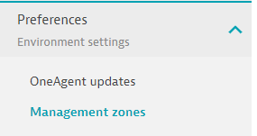
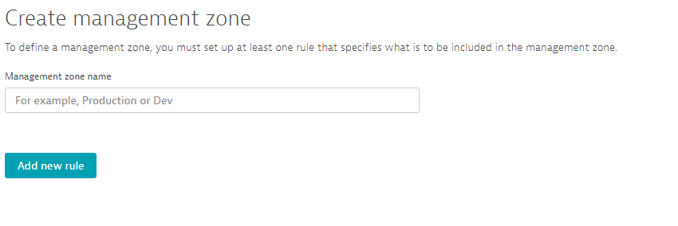
Creating a Management Zone
Settings -> Preferences -> Management Zones

Slide 36
Apply Rules Matching the desired ‘Zone’
Rules can be applied in the scope of Services, Process Groups, Hosts, Applications (Web, Enterprise, Mobile) and Synthetic monitors.
Choose a scope above and apply one or more rules to match the appropriate entities.
Many different combinations of rules can be used, Tags can also be selected as a drop down.

Slide 37
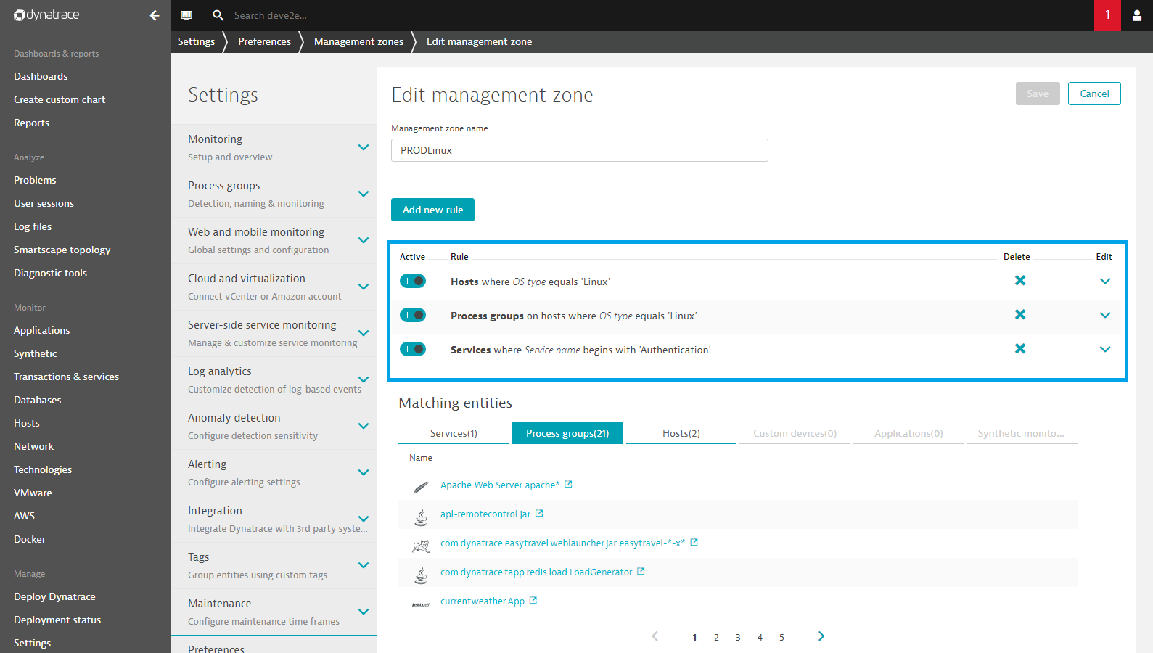
Set up Management Zones

Slide 38
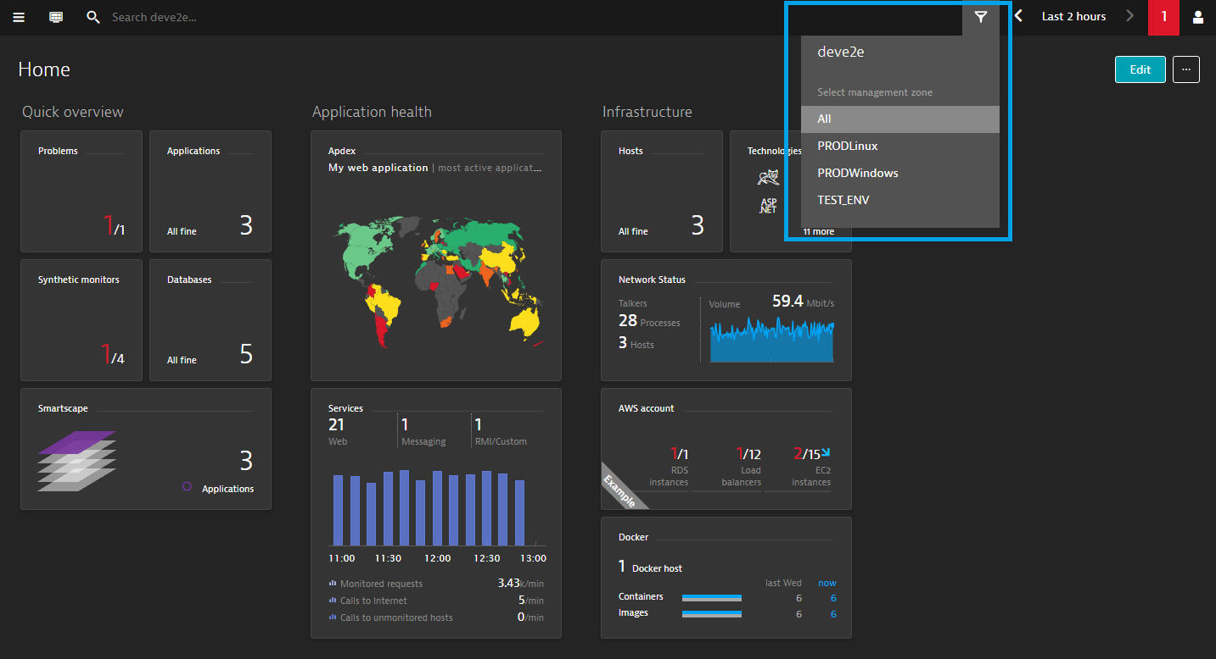
Select a management zone to focus on
Configured Management zones are available to filter on throughout the UI

Slide 39
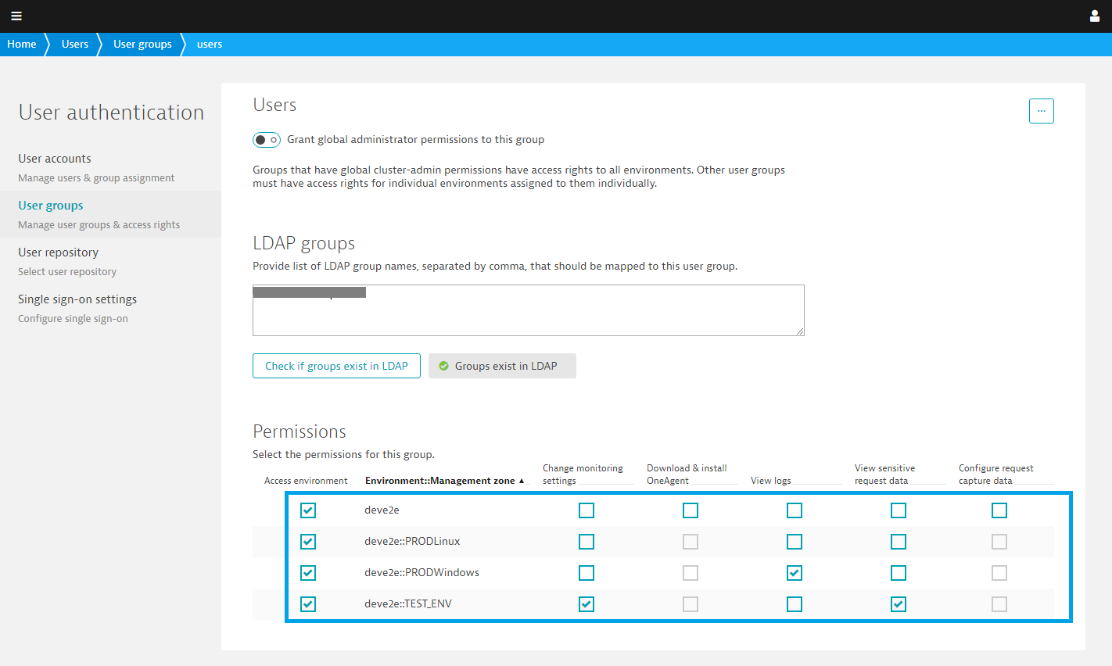
Assign access rights to management zones
Applicable to users and user group permissions with access rights to specific zones
In this way, users will only see those entities that are relevant to their work

Slide 40
Hands On: Management Zones

Slide 41
Hands On: Management Zones & Service Renaming
Goal: Separate your environment into Production and Test
Steps
Follow Steps in Lab 3
Follow Steps in Lab 4

Slide 42
Hands On: Management Zones & Service Renaming
Goal: Separate your environment into Production and Test
Steps
Create management Zones for Production and Test
Map your hosts into the correct zone
Apply to processes running on matching hosts
View the different zones through the UI

Slide 43
WebSphere Pitfalls
Techworkshop January, 2019

Slide 44
WebSphere Pitfalls
Agenda
item 1
item 2
item 3
Item 4
Item 5

Slide 45
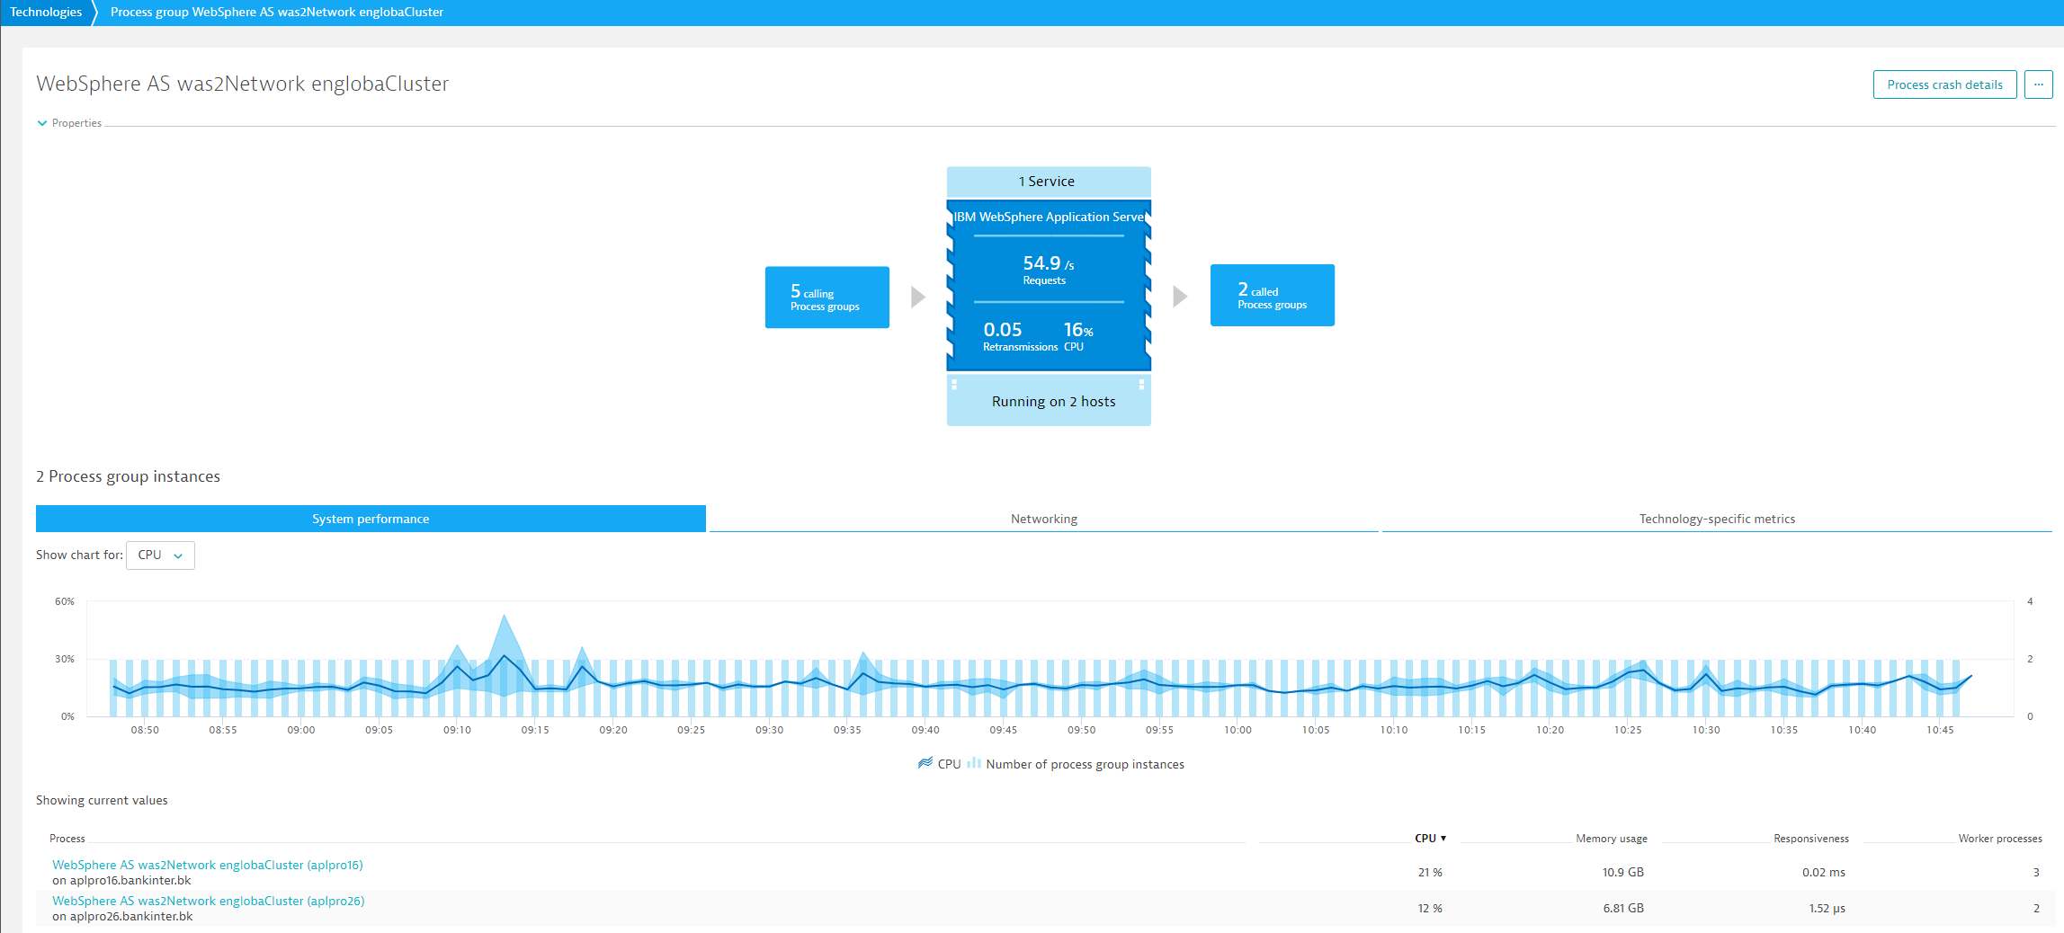
Cluster detection works quite well, but PGIs are merged if multiple WebSphere Servers are running on the same host (“Node” in Websphere speak)
WebSphere Cluster name (part of the PG)
Running on two hosts (Websphere Nodes)
PGI shows the “Websphere node” as part of its name
But on each hosts we have multiple instances of the same PG running

Slide 46
But the client want to see each of his JVMs on each host separated

Slide 47
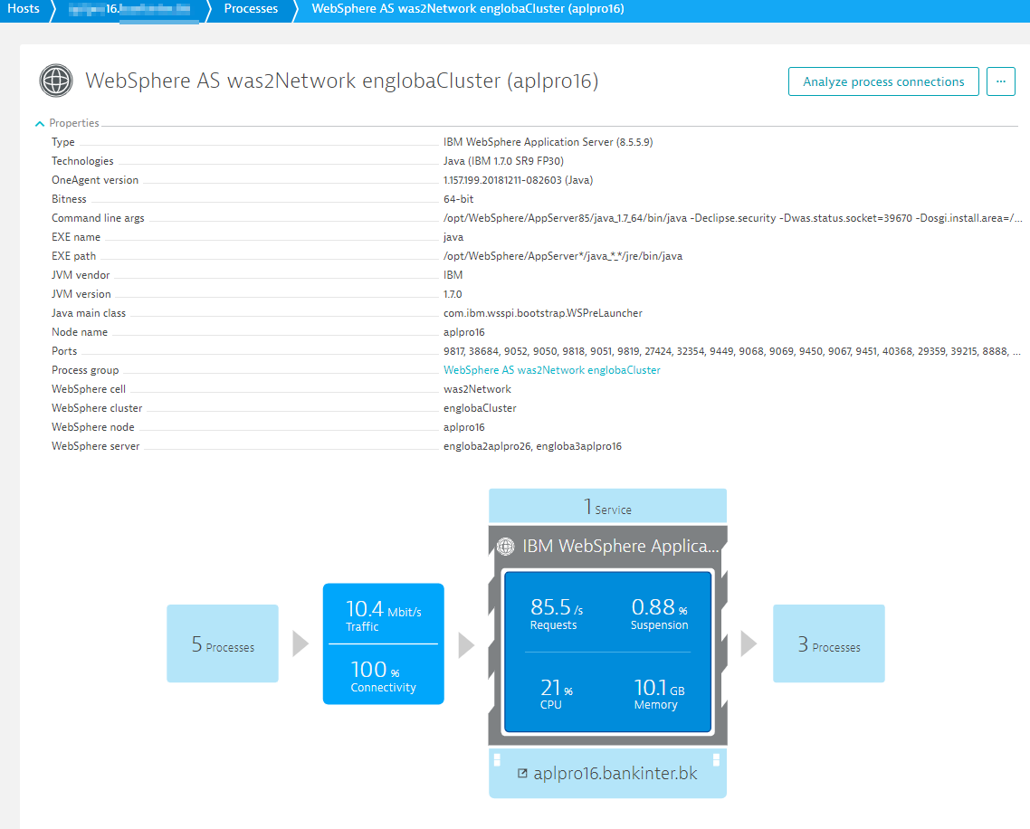
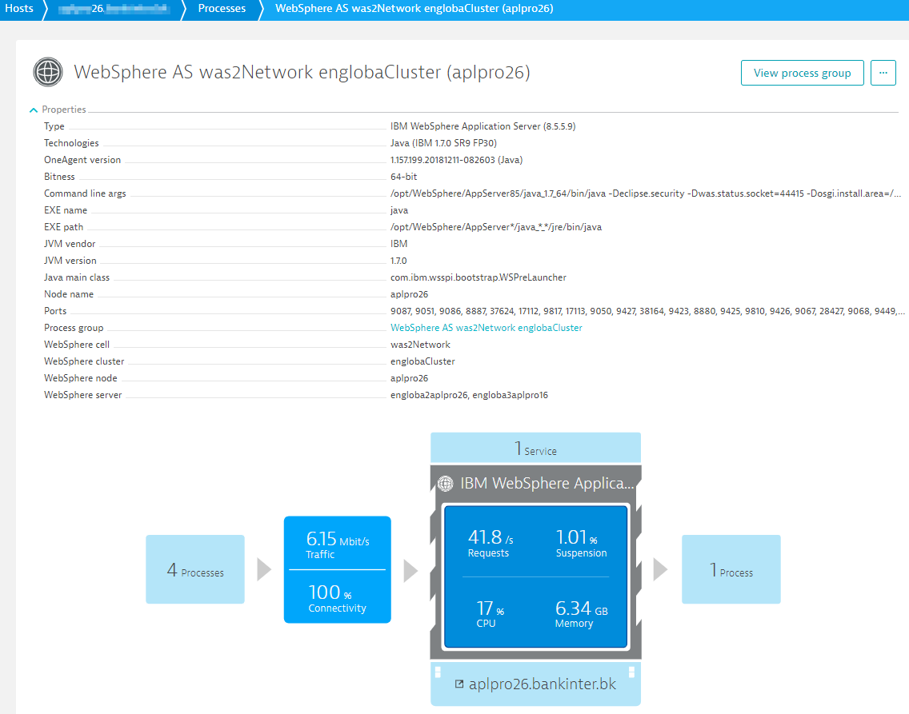
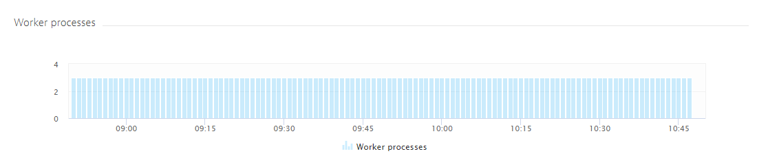
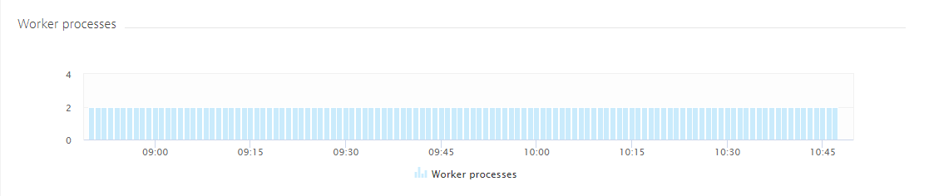
In case multiple JVMs of the same PGI are running on the same host…
Make sure WebSphere specific properties are detected
Make sure WebSphere specific properties are detected
3 JVMs belonging to the same PG are detected on this host and are fully monitored
2 JVMs belonging to the same PG are detected on this host and are fully monitored

Slide 48
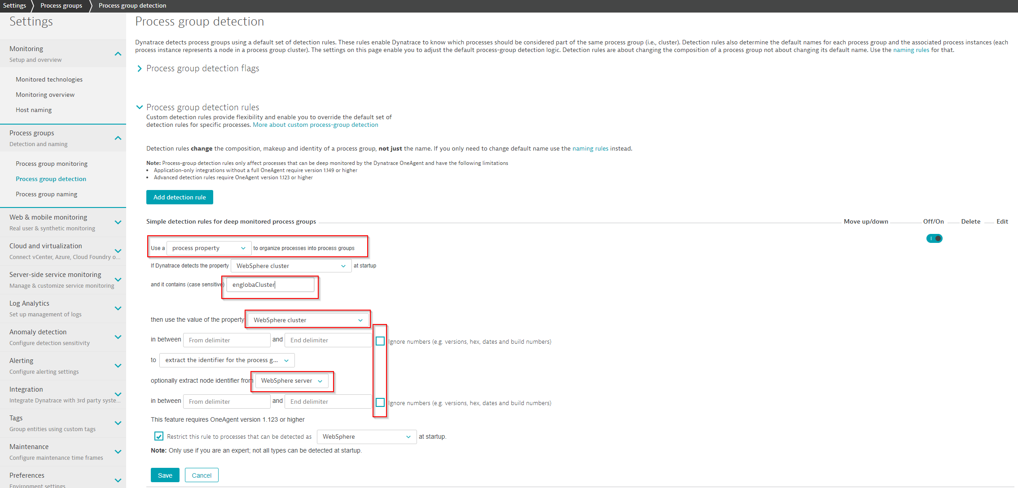
Process Property rules can help:
Define a detection rule based on a process property
As WebSphere Admins love numbers to distinguish between single instances, make sure OneAgent also considers them
(Numbers should NOT be ignored)
As multiple instances of the same WebSpere server (JVM) are running on the same host we need to make sure that a PGI is also split in this case
This rules are evaluated on startup time -> changes need a restart of the process

Slide 49
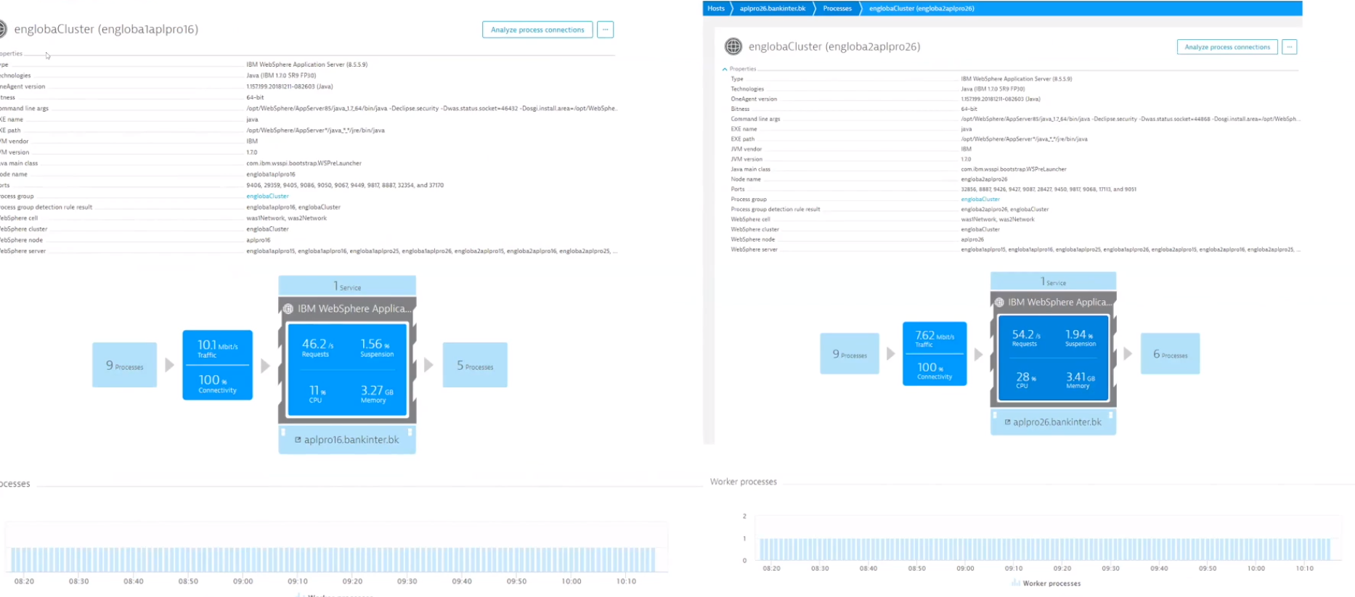
Now the PGI’s are also split into distinct nodes

Slide 50
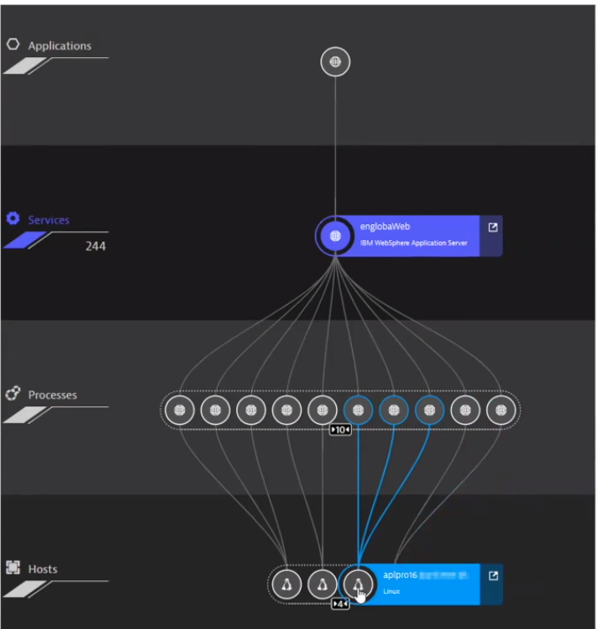
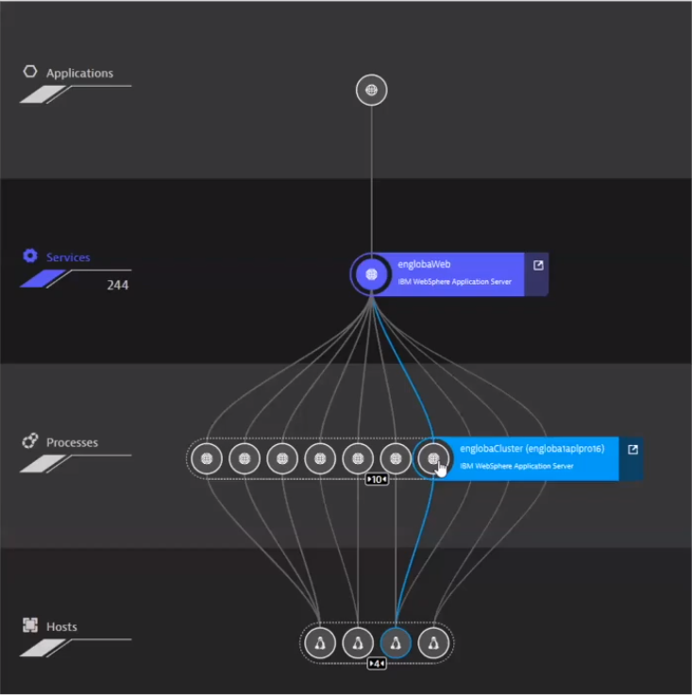
Smartscape View

Slide 51
Further Reading
https://www.dynatrace.com/support/help/how-to-use-dynatrace/entity-detection-and-naming/

